Slide 1




Fluorescent dissolved organic matter
Lofton, M.E., Cooke, R.L., and Carey, C.C. 20 September 2025.
Macrosystems EDDIE: Exploring Tradeoffs in Water Quality Management Using Environmental Data.
Macrosystems EDDIE Module 10, Version 1.
https://serc.carleton.edu/eddie/teaching_materials/modules/module10.html
Module development supported by NSF EF-2318861 and NSF RISE-2438447.
Notes:
In this video I will introduce fluorescent dissolved organic matter as a measure of water quality and describe how it can be used to indicate the presence of potential DBP precursors.

Slide 2

What is fDOM?
fDOM is fluorescent dissolved organic matter
Derived from living things (such as tree leaves or phytoplankton) and contains carbon
Is not made of particles, but is dissolved in water
If light is transmitted through the water, fDOM molecules will absorb it and emit a different wavelength of light – this is the process of fluorescence
The color in coffee is an example of dissolved organic matter.
Photo credit: Wikipedia
Notes:
Fluorescent dissolved organic matter, or fDOM, is derived from living things and contains carbon. It is not made of particles, but is dissolved in water. The color in coffee is an example of dissolved organic matter. And importantly, if light is transmitted through the water, fDOM molecules will absorb it and emit a different wavelength of light – this is the process of fluorescence.

Slide 3

Using fDOM to assess water quality
fDOM sensors measure the amount of fluorescence emitted by organic matter
How fluorescence is measured
sensor emits light at a specific wavelength into the water, which is absorbed by the organic matter molecule
organic matter molecule emits light at a different wavelength (this is fluorescence), and the emitted light is measured by the sensor
the difference in the light emitted and received by the sensor gives us a metric of the amount of organic matter in the water
organic matter molecule
Notes:
fDOM sensors measure the amount of fluorescence emitted by certain types of organic matter. First, the sensor emits light at a specific wavelength into the water, and the light is absorbed by an organic matter molecule. Next, the organic matter molecule emits light at a different wavelength. This is called fluorescence. The fluorescence emitted by the organic matter molecule is then measured by the sensor.

Slide 4
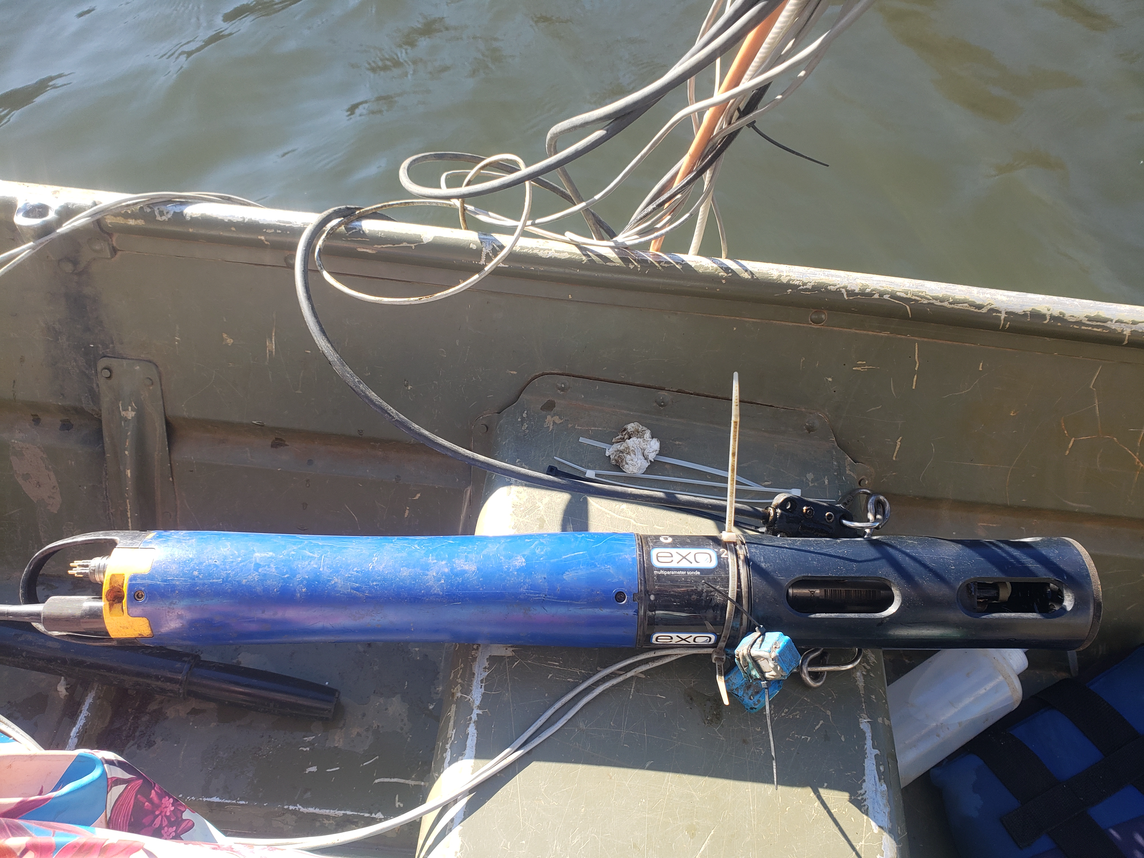
Using fDOM to assess water quality
fDOM is measured in quinine sulfate units (QSU)
QSU is an indirect measure that compares the amount of fluorescence emitted by organic matter in water to the amount of fluorescence emitted by a known quantity of quinine sulfate in a laboratory setting
sensors are calibrated using QSU to ensure consistent readings across sensors and reservoirs
QSU ranges from
YSI EXO sensor that measures fDOM
Notes:
fDOM is measured in quinine sulfate units, or QSU. QSU is an indirect measure that compares the amount of fluorescence emitted by organic matter in water to the amount of fluorescence emitted by a known quantity of quinine sulfate in a laboratory setting. Sensors are calibrated using QSU to ensure consistent readings across sensors and reservoirs.

Slide 5
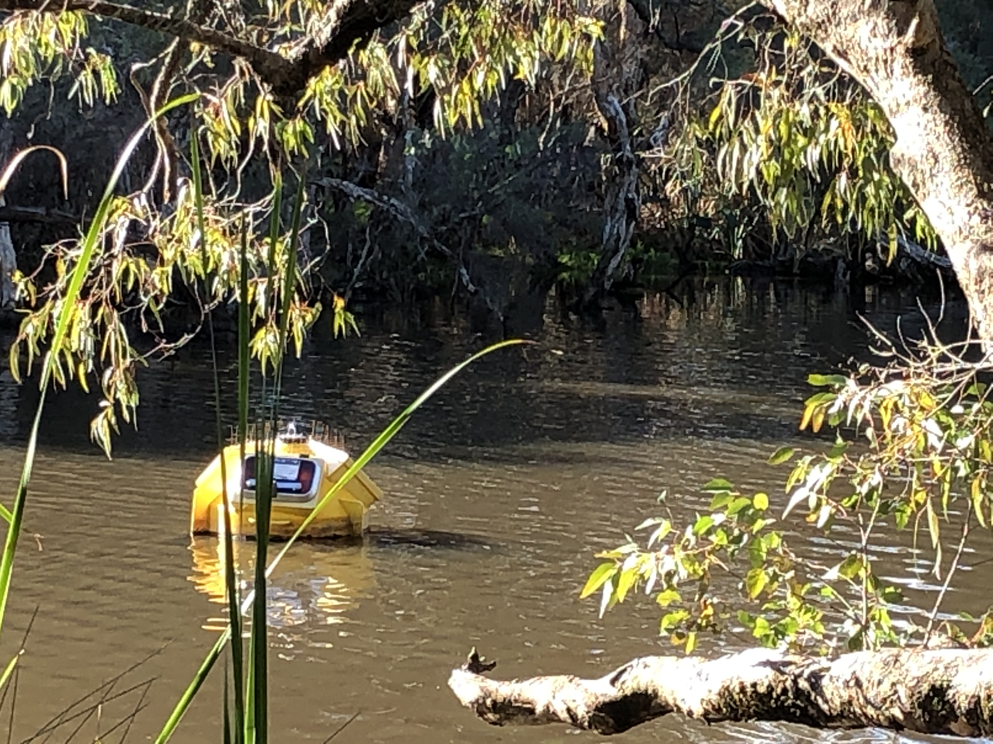
Using fDOM to assess water quality
Fluorescent dissolved organic matter (fDOM) is a measurement of naturally-occurring organic matter.
As we have learned, excessive naturally-occurring organic matter can lead to DBP formation during water treatment
fDOM does not measure all organic matter, but it can be an indicator of the presence of potential DBP precursors
Water colored with organic matter
Canning River, Perth, Australia
Photo credit: Mary Lofton
Notes:
Fluorescent dissolved organic matter (fDOM) is a measurement of naturally-occurring organic matter in water. And as we have learned, excessive naturally-occurring organic matter can lead to DBP formation during water treatment. Thus, while fDOM does not measure all organic matter, it can be an indicator of the presence of potential DBP precursors.

Slide 6
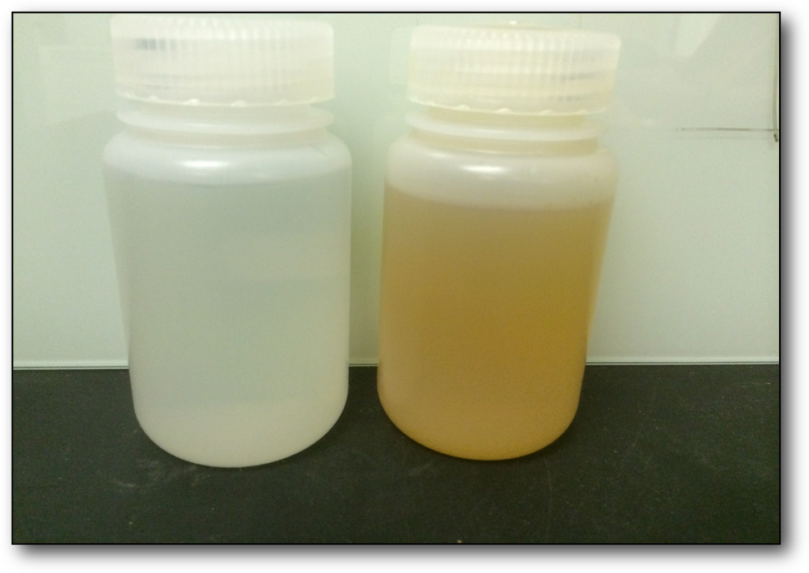
DBPs are monitored using TOC
Raw and filtered water are tested once a month for Total Organic Carbon (TOC)
High TOC levels can indicate the presence of DBP precursors which may form DBPs during treatment
Water samples from Falling Creek Reservoir, Vinton, VA
Photo credit: Bethany Bookout
Notes:
Recall from the introductory presentation that TOC, or total organic carbon, is one way that water managers can monitor for DBP precursors. Typically, TOC measurements of both raw and filtered water are taken once a month. High TOC levels can indicate the presence of DBP precursors, which may form DBPs during treatment.

Slide 7

Relating fDOM to total organic carbon (TOC)
While fDOM and TOC are not exactly the same, we can use statistics to make a relationship that converts fDOM (in quinine sulfate units) to TOC (in milligrams per liter)
With this relationship, fDOM data can help us detect the presence of potential DBP precursors and assess DBP formation risk
TOC
fDOM
Notes:
And while fDOM and TOC are not exactly the same, we can use statistics to make a relationship that converts fDOM (in quinine sulfate units) to TOC (in milligrams per liter). With this relationship, fDOM data can help us detect the presence of potential DBP precursors and assess DBP formation risk. The nice thing about this is that fDOM sensor often take measurements at a high frequency, many times a day, and these measurements may be available to water managers in real time. This can make fDOM measurements a useful tool to assess DBP risk.

Slide 8
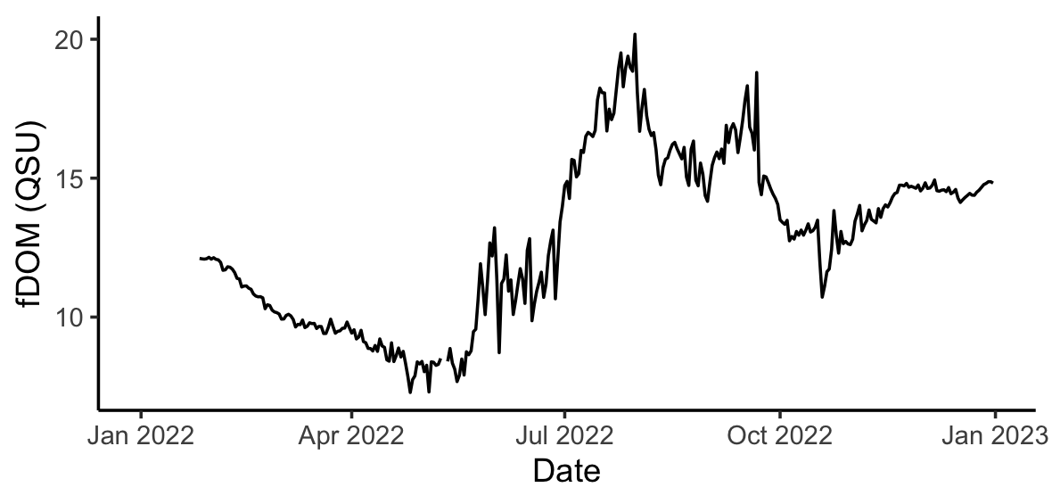
Using fDOM to assess DBP risk
A reservoir may be at risk of experiencing water quality degradation due to DBP formation when fDOM is elevated.
Elevated fDOM = Elevated risk of DBP formation
Notes:
In general, a reservoir may be at risk of experiencing water quality degradation due to DBp formation when fDOM is elevated. In the example figure shown on this slide, DBP formation risk is highest when fDOM is highest, because this probably means that TOC is also relatively high and there may be DBP precursors in the raw water.

Slide 9
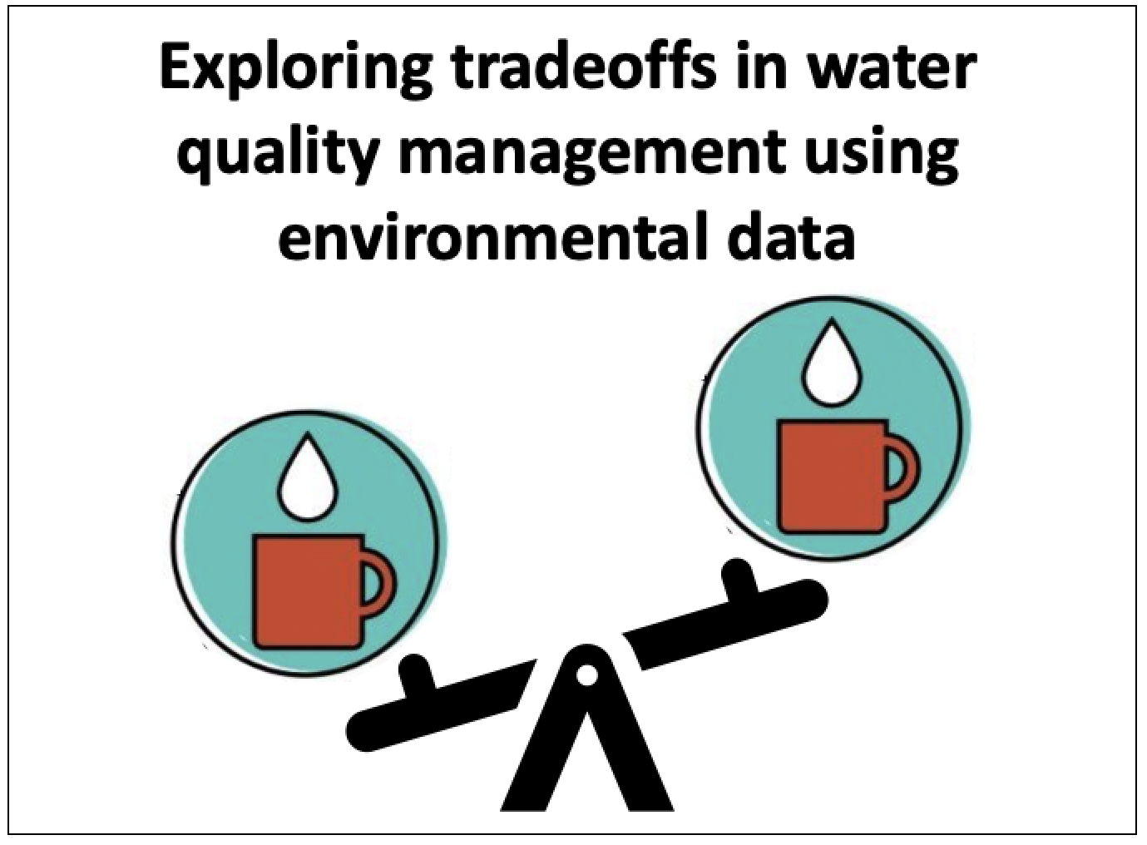
End of slideshow – please proceed with module activities!
Notes:
This is the end of the video; thanks for your attention!

